Slide 1


Mosquito Management and Arbovirus Surveillance in Vermont
Alan C. Graham and Erica Berl
http://www.vermontagriculture.com
http://healthvermont.gov/prevent/arbovirus/index.aspx

Slide 2
Topics
Mosquito Life History
Mosquito Surveillance
Arbovirus Surveillance
Mosquito Larviciding
Wetland Restoration Work

Slide 3
Terms (Jargon)
Arbovirus = Arthropod Borne Virus
Dipper Counts = number of larval mosquitoes in a mosquito sampling cup
Pool Sample = Mosquito adults grouped by species into a sample containing 1-50 mosquitoes so that they can be tested for virus activity.
Threshold Level = The level of an insect population which triggers an action for control measures.

Slide 4
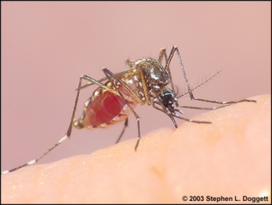
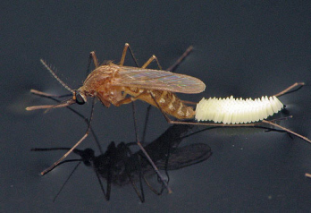
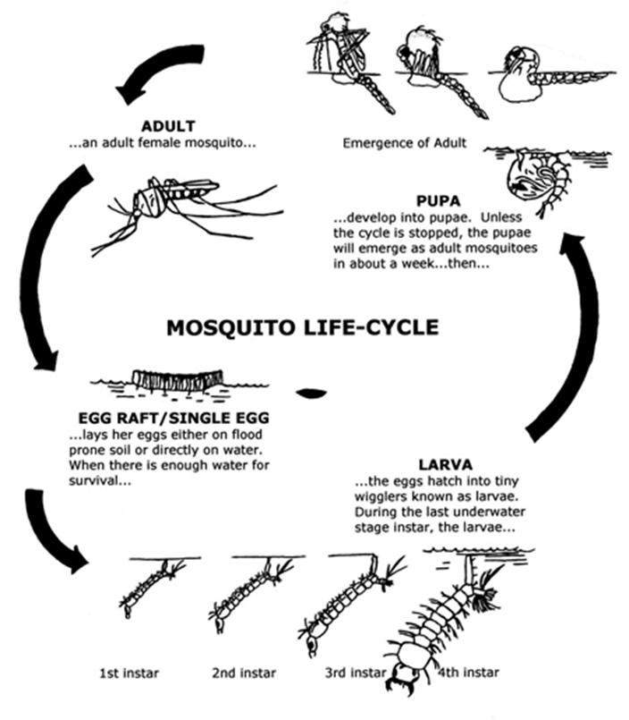
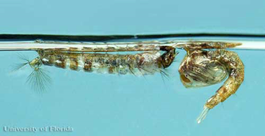


Slide 5
Basic Mosquito Life Histories
Spring Species
Flood Plain Species
Artificial Container Species
Swamp species
Cattail Marsh
Hardwood Swamps
Scrub/Scrub wetlands

Slide 6
Over-Wintering Strategies
Egg – most species
Adult – two genera
Larva – one species

Slide 7
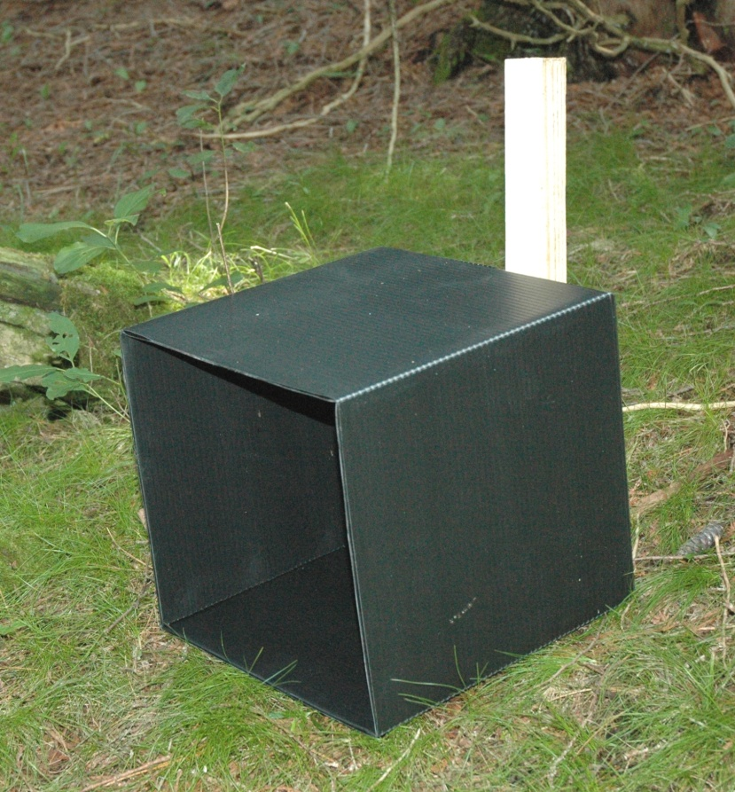
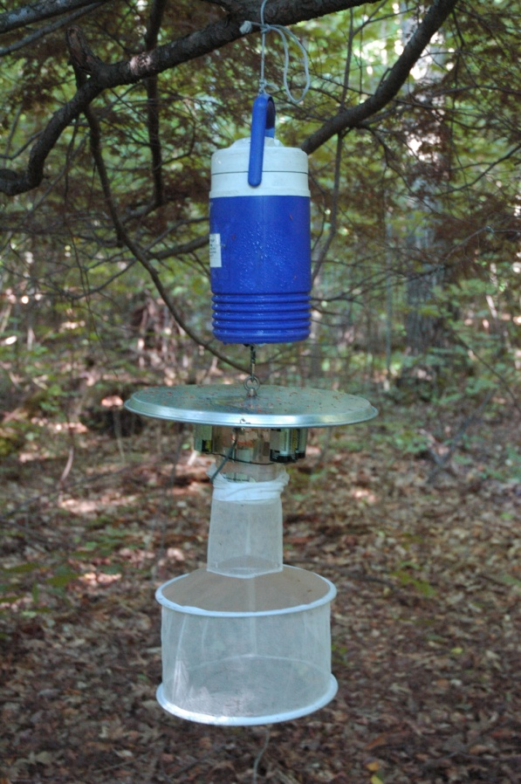
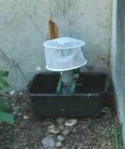
Adult Surveillance
Coroplast Resting Box Traps
CDC Light Traps
Gravid Traps

Slide 8
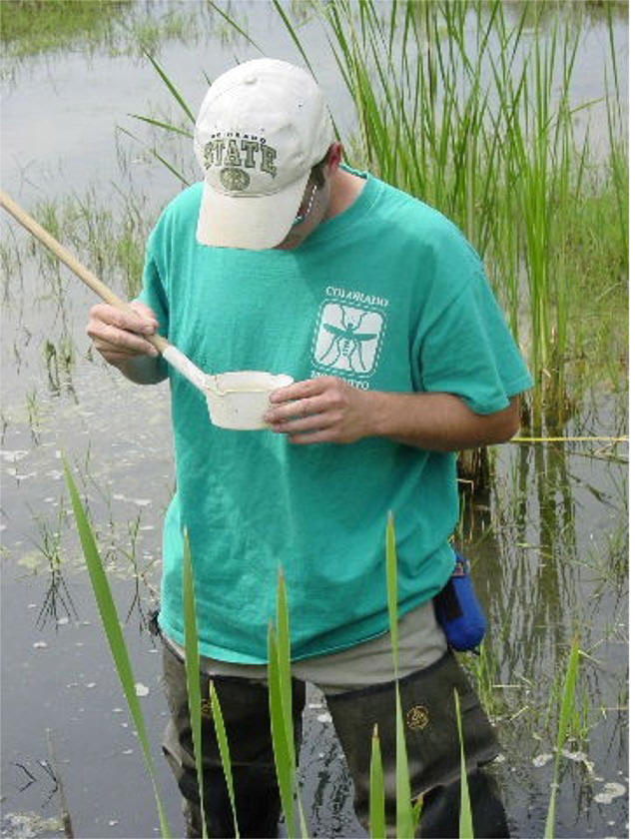
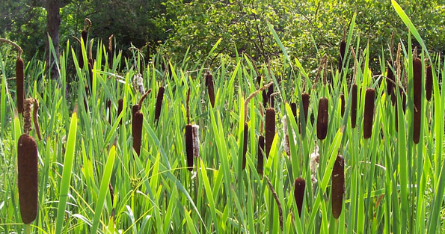
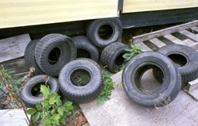
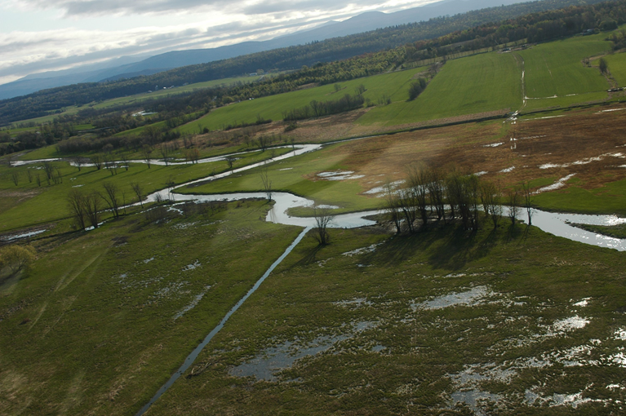
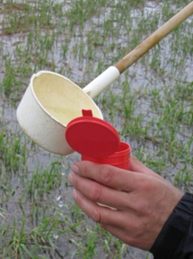
Larval Surveillance

Slide 9
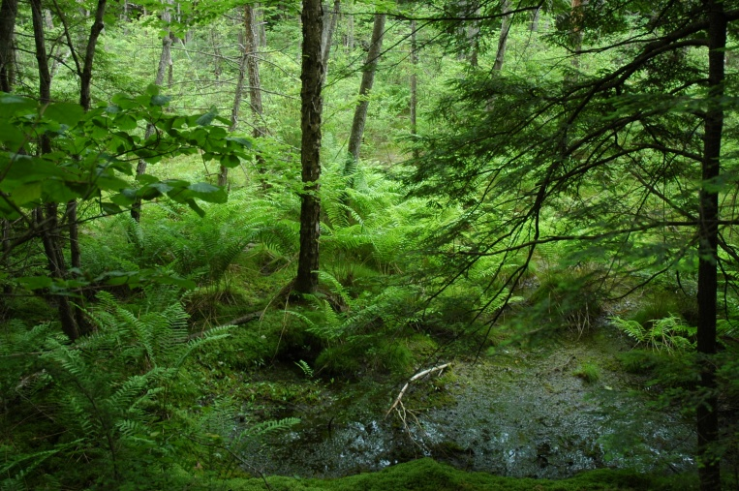
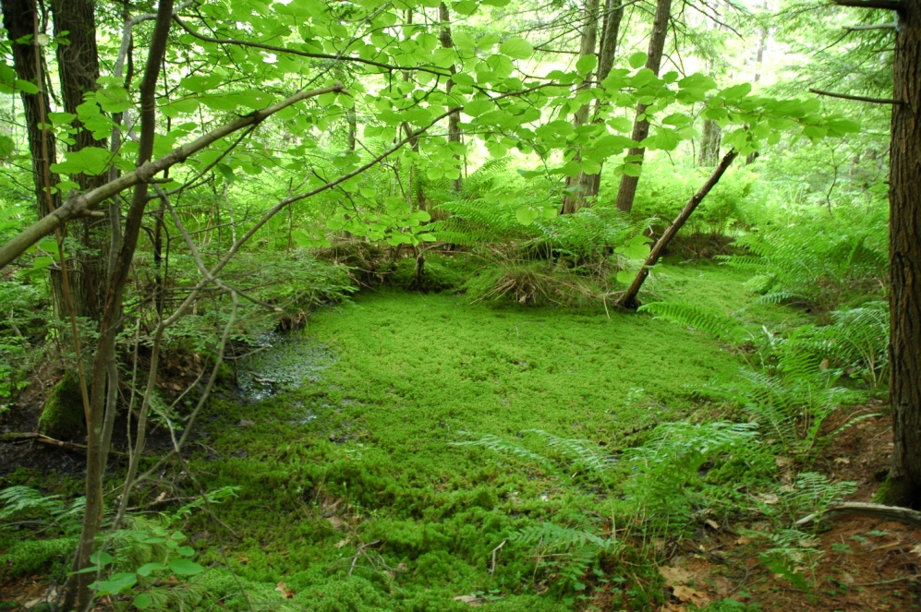
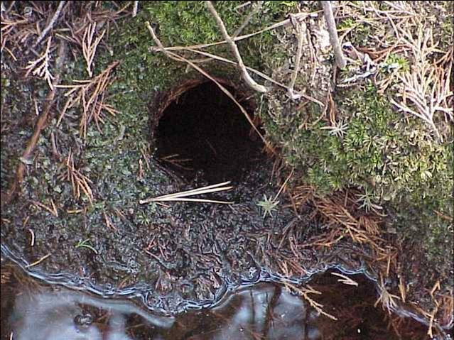
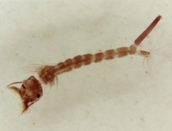
Focus on Culiseta melanura habitat
Prefers Acidic Hardwood swamps
Larvae found in holes under root masses

Slide 10
Organized Mosquito Districts in Vermont
BLS District
  Brandon, Goshen, Leicester, Salisbury
LFICD District
  Bridport, Cornwall
Weybridge District
  Weybridge

Slide 11
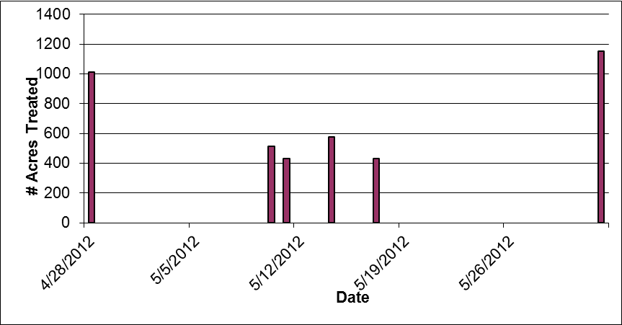
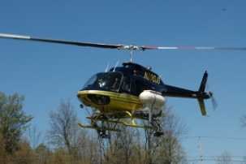
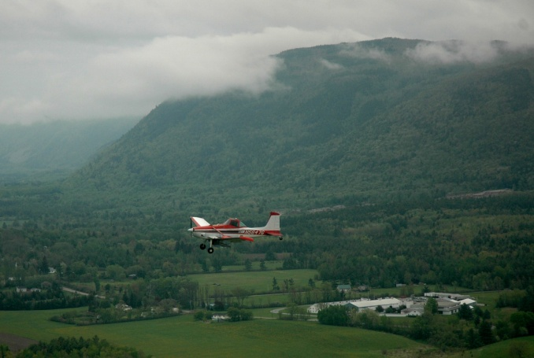
2012 Larval Suppression Efforts
5 Dates
  4/28 to 6/1
4118 Acres
10.81 tons BTI

Slide 12
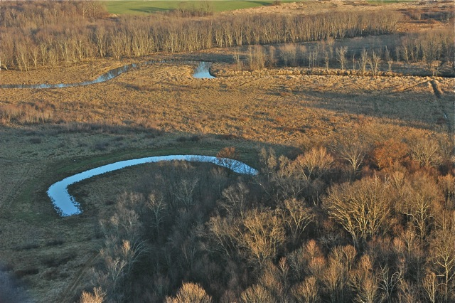
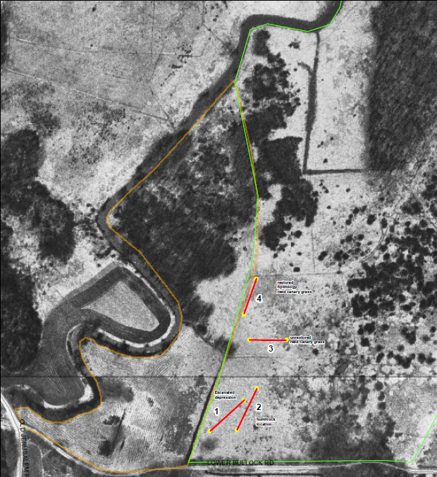
Wetland Restoration Work
USAD Collaboration
Larval surveys
5 Wetlands
4 Towns
“Making Wetlands” controversy

Slide 13
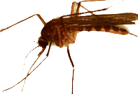
What is Eastern Equine Encephalitis (EEE)?
Caused by a mosquito-borne virus (like West Nile Virus - WNV)
Eastern half of the US
Not a new virus in the US
Enzootic in birds – lives in passerine birds (perching song birds)
  En = in Zootic = animals
  Transmitted among birds by bird-biting mosquitoes

Slide 14
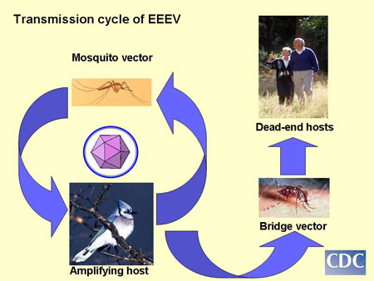
EEEV Transmission Cycle
?
Culiseta melanura
Aedes, Coquillettidia, Culex species

Slide 15
What is EEE?
Infection when mosquitoes feed on infected birds and then feed on humans/animals
Illness is rare in people
  < 300 human cases in the past 50 years nationally
  Becoming more common in the northeast?
    Past decade, new activity detected in NH, ME, Quebec, Clinton County (NYS) and now VT
    MA noticing more sustained activity

Slide 16
What is EEE?
Onset 4 – 10 days after bite from infected mosquito
Illness can be severe
  1/3 of serious infections end up being fatal
  1/3 of those who recover have continuing neurologic problems
Symptoms of severe disease:
  Fever, headache, irritability, restlessness, drowsiness, poor appetite, vomiting, diarrhea, mental status changes, seizures and coma

Slide 17
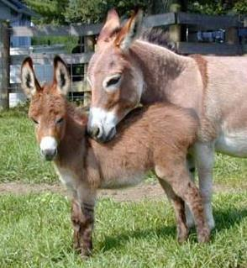
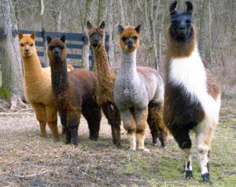
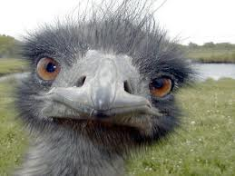
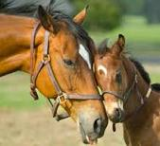
Other species affected:
  horses and donkeys
  llamas and alpacas
  emus and pheasants
Vaccine licensed for horses – may also be effective in llamas, alpacas and emus

Slide 18
2012 – Human cases
2 EEE cases
Rutland County residents
Onset dates Aug 13th and Aug 27th
Confirmed on Aug 31st
Both died of the illness

Slide 19
Veterinary cases
2 EEE horse cases
Rutland and Addison Counties
Onset dates Sept 6th and Sept 16th
One survived

Slide 20
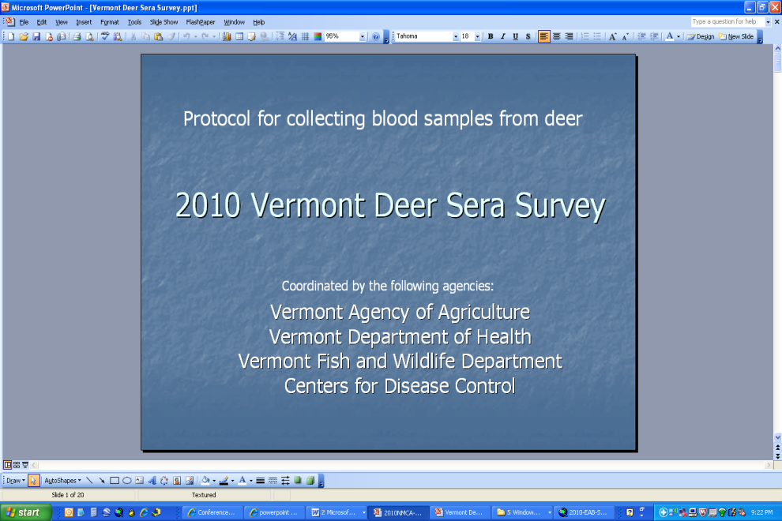
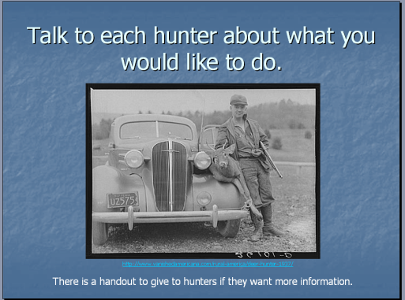
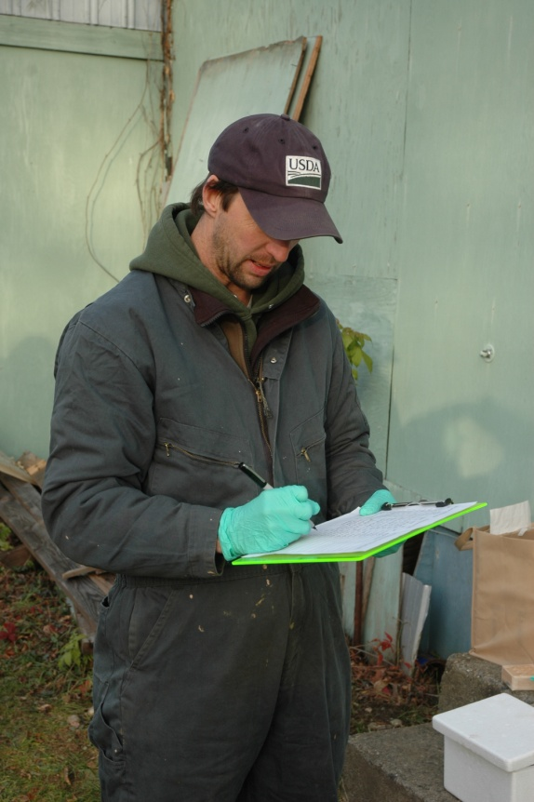
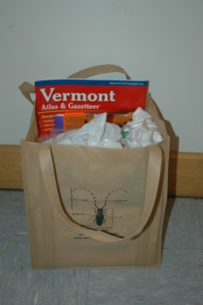
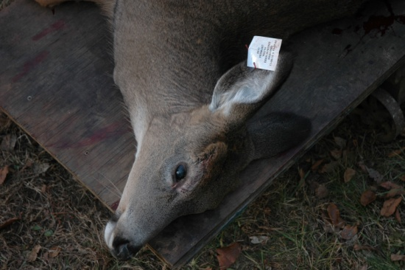
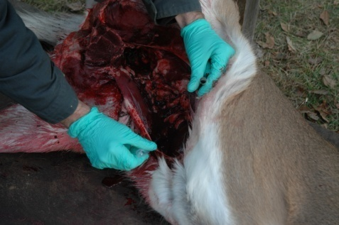
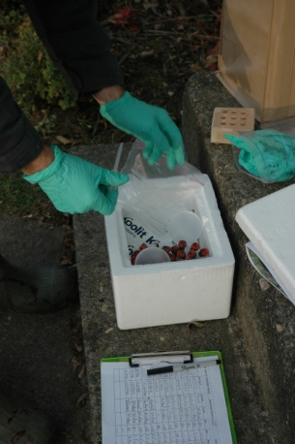
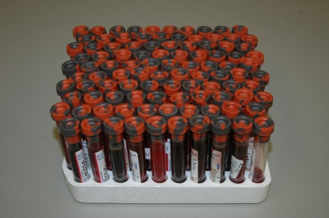
Vermont Deer Sera Survey

Slide 21
Human Serosurvey Research Project
Question: How many mild cases or asymptomatic cases result from EEE infection?
Study will determine how many people in the area have evidence of exposure to the virus but did not become ill.
Asking for volunteers who live in the towns of Sudbury, Brandon or Whiting
  Blood sample
  Questionnaire
Clinic dates
  Brandon: April 23rd (Senior Center, 10:00 – 7:00)
  Sudbury: May 14th (Town Hall, noon to 7:00)
  Whiting: May 29th (Town Hall, noon to 7:00)

Slide 22
For More Information
Vermont Agency of Agriculture
  http://www.vermontagriculture.com/
  Search for “Entomology”
Vermont Department of Health
  http://healthvermont.gov/
  Search for “Diseases and Prevention”
Agriculture - AlanGraham@state.vt.us
Health - Erica.Berl@state.vt.us

Slide 24
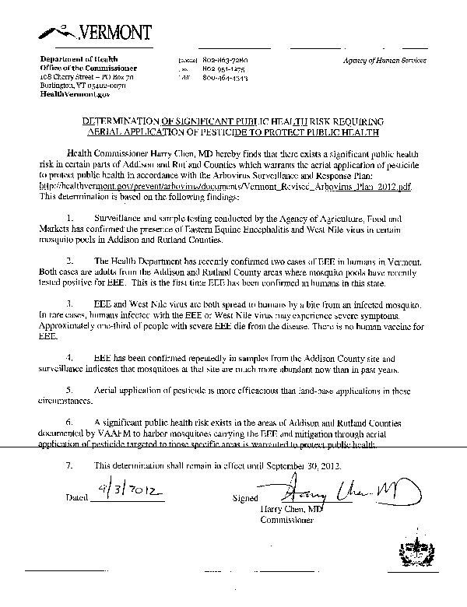
Declaration of Public Health Risk
Phone conferences
Declared Sept 3
Addison and Rutland Counties

Slide 25
Arbovirus Consultation Group
John-Paul Mutebi
Roger Nasci
Wayne Andrews
Richard Pollock

Slide 26
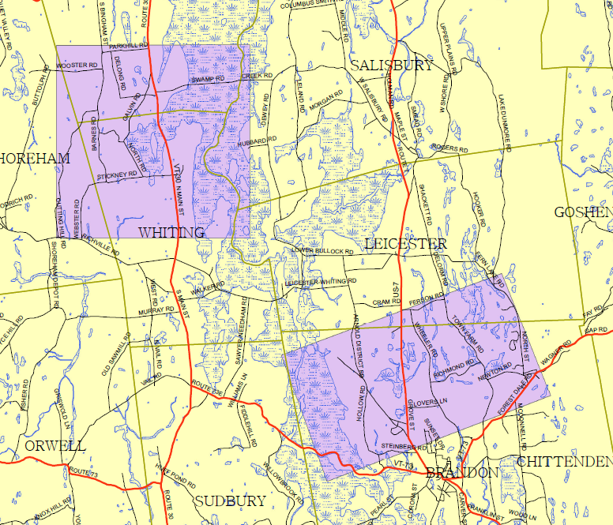
Proposed Treatment Areas
Towns of Whiting and Brandon
2 mile radius concept
NOFA organic farm buffers
Apiary locations
Public Education
Public Awareness

Slide 27
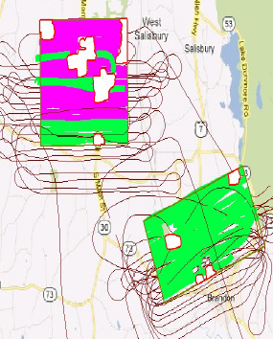
Aerial Adulticide Treatments
Dynamic Aviation
Anvil 10+10
0.62 Oz/acre
Nights of Sept 7 and 8
19,543.8 acres
91.0 Gals
Swath 1,000 feet

